Slide 1
Social Justice Philanthropy
COFIE Presentation
February 11, 2014

Slide 2
Two questions

Slide 3
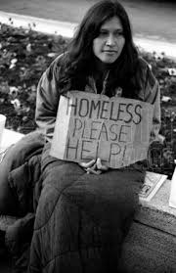
Question 1
Imagine driving or on the bus
You see a woman with a sign
Out of work
2 kids
Anything helps
What do you think the people in the other cars are thinking?

Slide 4
Question 2
Why are people poor?

Slide 5
What Makes social justice philanthropy different?
Notes:
Activity

Slide 6
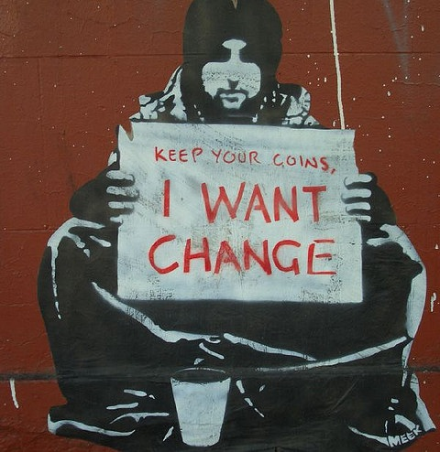
What Makes SJP Different?
Aims at root causes, not symptoms
Changes power relations
Communities determine solutions
Challenges oppression: racism, sexism, classism, heterosexism, ableism
Notes:
Root causes
Long-term structural change
Social justice philanthropy
Talk about: “Give a man a fish…”

Slide 7
What Makes SJP Different?
Constituent-Led:
Leadership is from community most impacted by issue or injustice
Lasting Effect:
Work is addressing root causes of injustice, and affects not just people today but also future generations. Work is directed toward permanently changing a system,
institution, or policy.
Community Wide:
Change is inclusive of
all members within a
specific community

Slide 8
Example: Prax(us)
Problem: Homeless youth are vulnerable to human trafficking.
Solutions:
Make sure homeless youth are safe (shelters)
Provide homeless youth other opportunities (job training)
Stop youth from being homeless (family support)
End criminalization of homelessness and prostitution (police reform, education/advocacy)
End oppression (anti-trans policies/culture, youth empowerment)
Goal: End Human Trafficking
Notes:
Discussion – what are possible solutions to get to the goal? Discuss how solutions can vary; what are the ones that address the “root causes”?

Slide 9
How does social justice philanthropy work?

Slide 10
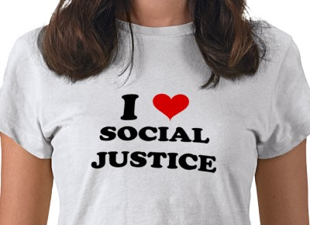
Who Gets Funded
Groups based in communities of color, low-income communities, LGBTQ communities, or other communities facing injustice or oppression.
Budgets < $350,000
General operating support
Grantees evaluated on:
constituent-led,
community-wide,
lasting effect
(programs and organization)

Slide 11
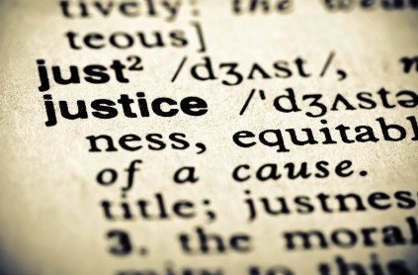
Who Gets Funded
Start-Up Grants: groups that are less than 4 years old.
Do not need a proven track record of success. May not be 501(c)3.
Maximum grant award is $4,000.
Established Grants: available to any group.
Maximum grant award is $10,000.
Notes:
Would your foundations put aside 1-5% for “risky” groups?

Slide 12
Docket discussion
Notes:
Discussion: Hand out grants docket, have a few minutes for people to look over decisions and discuss what they observe.

Slide 13
Power in social justice philanthropy

Slide 14
Grant Making Committee
Diversity: Made up of social justice activists from diverse communities across the state
Activist-led: Committee members have direct experience working on the ground and can recognize effective work when they see it
Leadership Development: Activists develop their own leadership, build solidarity and connections across movements, and learn about new methods for social change – which they take back to their own organizations and communities
Notes:
GMC is a skill-building tool – activists build leadership skills within the committee. Also a board recruitment tool.

Slide 15
Board Perspective
I’m not on the Grant Making Committee.
My vote of the grant docket is a symbolic vote of solidarity.
Board involved with anti-oppression work – expected to go through anti-oppression training, show up for workshops, “walk the talk”.
Board diversity:
community-wide.

Slide 16
Small group breakout

Slide 17
Challenges

Slide 18
Challenges
Board/Grant Making Committee relations
Board has strategic vision for Chinook, budget, but…
What do we know better than the activists themselves?
When does a group “graduate” from Chinook Fund? For example: Land Rights Council first grant in 1992. Yet, there is still so much work to be done in their area.
How do we engage high level donors we need in our work? Careful vs. “real” language around class and oppression? Designated funds?
Measuring effectiveness: How do we, or our grantees, measure effectiveness?
Transaction vs. transformation
Notes:
What are your experiences in your own foundations?

Slide 19
Discussion and Questions
Notes:
Brenda: Bring back to “What Can I Do?”

